Slide 1

Thoreau’s Guide to Life

Slide 2
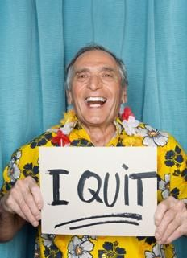
Quit Your Job
“Go confidently in the direction of your dreams! Live the life you’ve imagined. As you simplify your life, the laws of the the universe will be simpler.”
“But men labor under a mistake… It is a fool’s life, as they will find when they get to the end of it, if not before.”

Slide 3
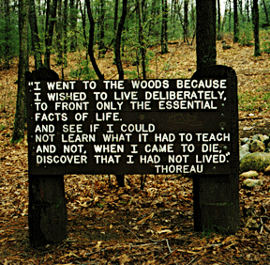
Move to the Woods
“I lived alone, in the woods, a mile from any neighbor, in a house which I had built myself, on the shore of Walden Pond.”
Notes:
Read quotes
We’ve all seen this picture in class, the sign is there on Walden pond and is an excerpt from Walden.
Thoreau moved to the woods to get the full experience; he was rejecting society, becoming his own teacher, and living freely from any pressures or societal norms. By isolating himself, he was able to fully connect with God on a very personal level and assert his independence.

Slide 4
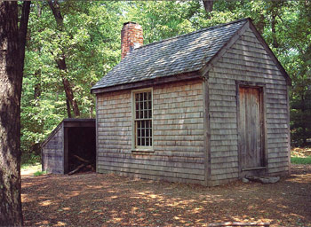


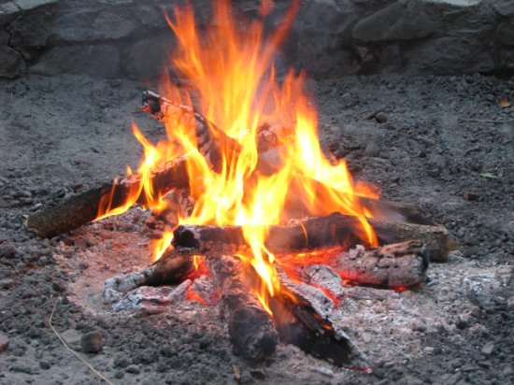
The Four Necessities
Food
Shelter
Clothing
Fuel
“Man’s body is a stove, and food the fuel which keep the internal combustion in the lungs.”
Notes:
Oxen eats only vegetables pg. 5

Slide 5
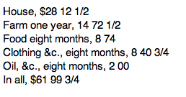

Keep it Cheap
Stay out of debt
$0.27 a week for food
  $6.24 today
Notes:
Harvard man, not actually struggling to make ends meet; he chose this lifestyle so he has the luxury of spending as much as needed.

Slide 6

Learn by Doing
“I mean that they should not play life or study it merely while the community supports them in this expensive game, but earnestly live it from beginning to end.”

Slide 7

Do Nothing
“Few phenomena gave me more delight than to observe the forms which thawing sand and clay assume in flowing down the sides of a deep cut on the railroad.”
“I have a great deal of company in this house, especially in the morning when nobody calls.”

Slide 8
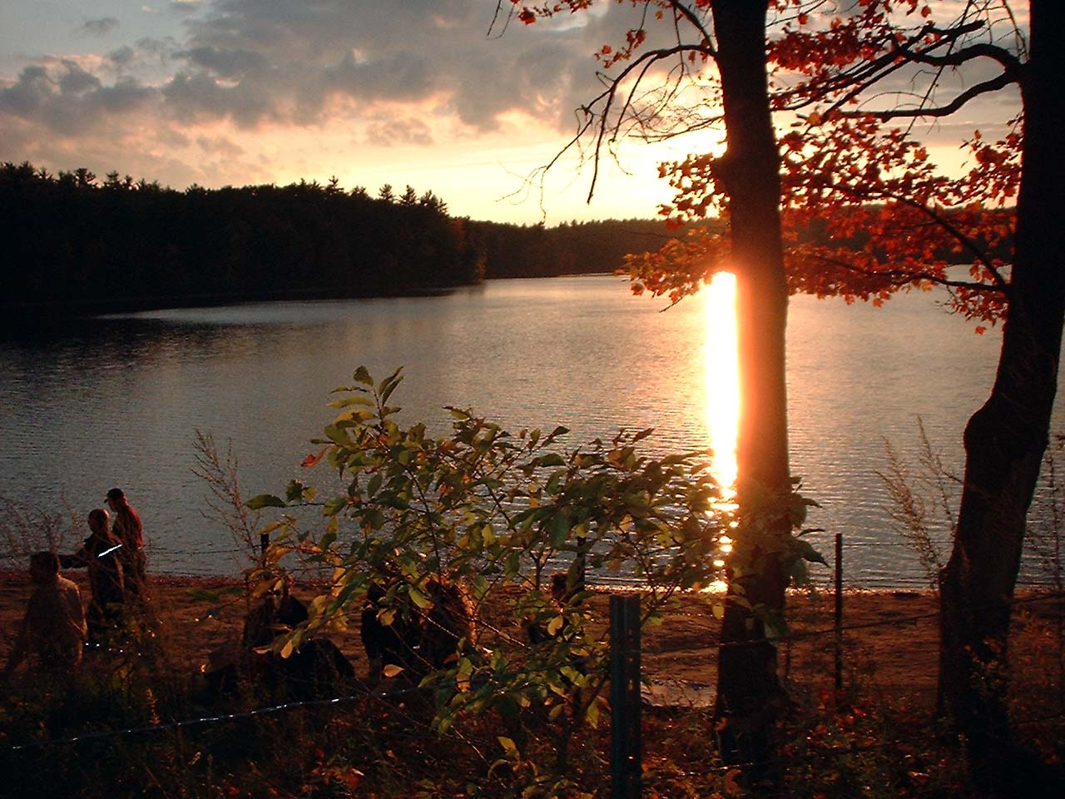
Finding Life Within Yourself
Find the beauty in the nature
Connect with God
Find happiness in simplicity
Reject society
“In short, I am convinced, both by faith and experience, that to maintain one’s self on this earth is not a hardship but a pastime, if we live simply and wisely; as the pursuits of the simpler nations are the sports of the more artificial.”
Notes:
This is the essence of Walden; Thoreau exiled himself in an attempt to find inner strength, peace, happiness, spirituality and independence. For over two years he lived alone, spending as little as possible, rejecting society and embracing his experience with nature and God. This final quote reads… and, to me, this was Thoreau’s ultimate lesson: he proved that life does not have to be a struggle, even with no money or possessions or companions, life can still be a freeing and wonderful experience. We don’t have to succumb to the confines of society, we can live however we choose, seeking our own happiness and ultimately, we will not only have survived, but will have lived.

Slide 9
“If a man does not keep pace with his companions, perhaps it is because he hears a different drummer. Let him step to the music which he hears, however measured or far away.”
-Henry David Thoreau
Notes:
Find your happiness – if you want to go out into the woods, go. Do whatever will make you a happy person. “I don’t want to survive, I want to live” -Thoreau

