Slide 1
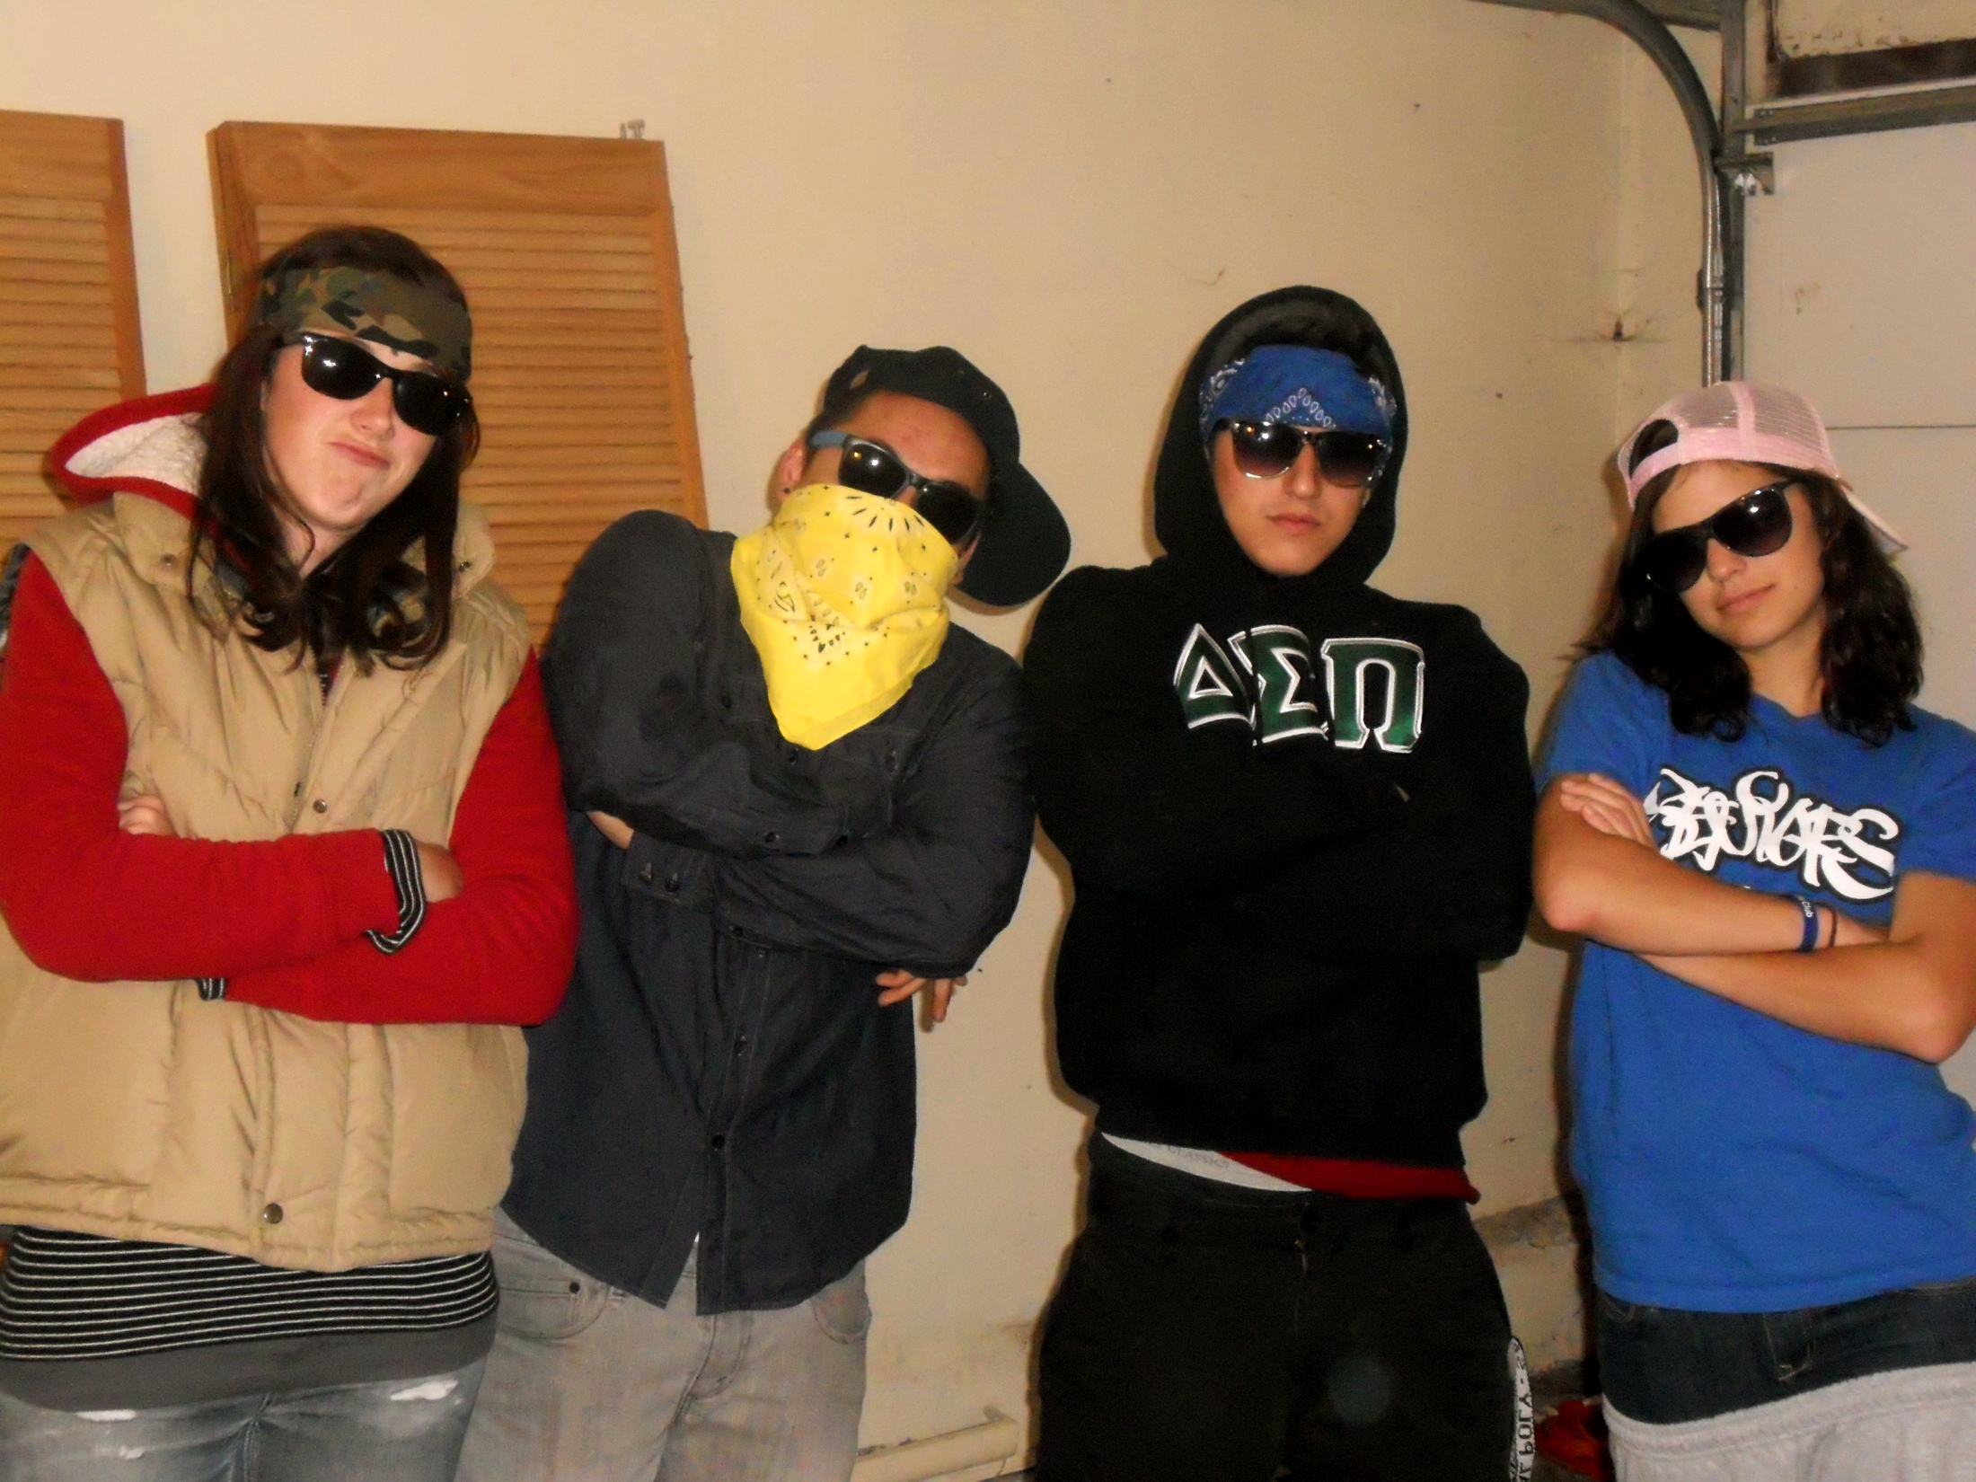
Today Chabert Had a Bad Day
Colleen Meagher Austin Levine
Lambert Nguyen Katya Lemak

Slide 2
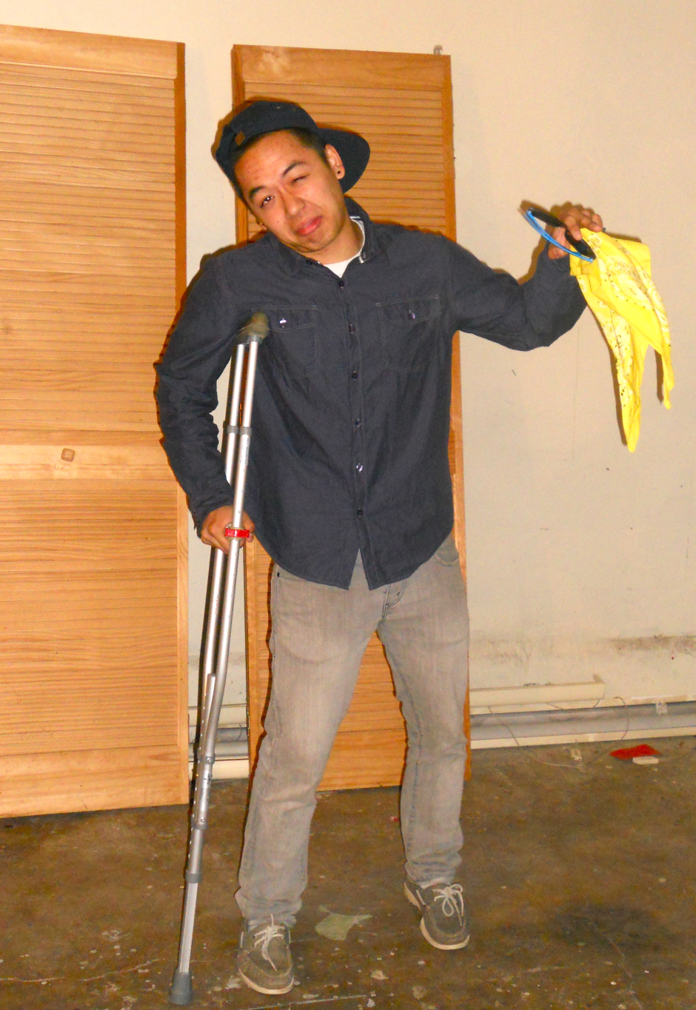
Yo, his name is Colonel Chabert,
A guy so disfigured people stare,
In the lawyer’s office for the fifth time,
Tryna afford something more than a dime,
Gutter-jumpers tell him to come back later,
Whatever, he’s not a big debater

Slide 3
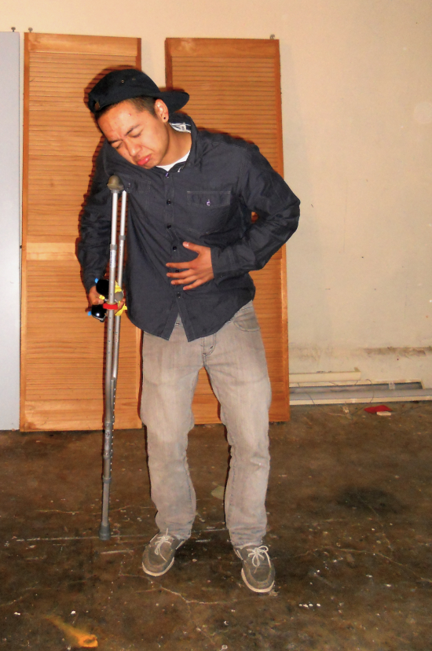
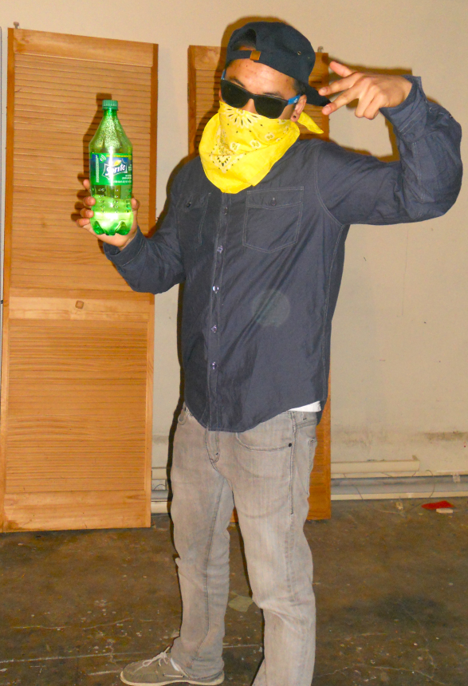
Always calm and polite, can he get a sprite
Maybe some clothes, food, some wata
Even the location of his baby mama
All he wants is the lawyer Derville,
Get bills, his name back, and chill,
What happened to the old honor code,
Messing with old people is not the road

Slide 4


Nobody believes me :(
Going back to Derville
Who thinks he’s ill
Gotta prove him wrong
Gotta keep going strong
Fool’s been stranded 9 years
And all he’s got are tears

Slide 5




In battle one day
Double teamed by the Russians
Got a nasty concussion
Field doctors were rushin’
Didn’t check if blood gushing
When they called him dead
BLOOD!

Slide 6
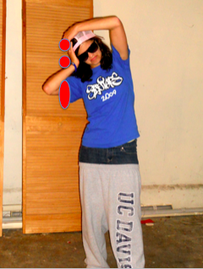
But he rose up from the dead
With a gash on his head
The Germans saved his life
When he was ditched by his wife
Called him crazy when he said
That Chabert’s his name
And he wants back his dame
But he’s getting Derville to file his claim

Slide 7


Derville, always willing to give money to the cause
His patriotism, one of his only flaws
German letter on his desk, who
could it be fo’
Hey Boucard, Imma need you to translate this, bro

Slide 8
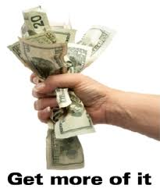
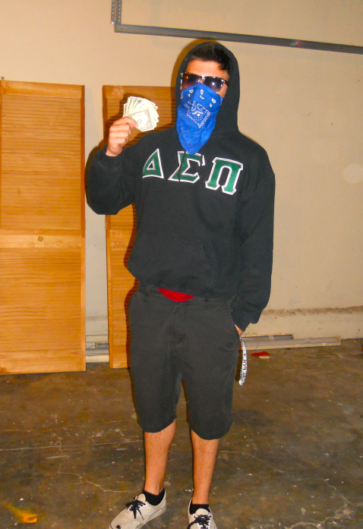

Chabert’s fortune only worth three hundred thousand francs
Be careful when you marry, they’ll take half your bank
Half to the wife, half to the state
She’ll take what you’re worth, turn around and find another date

Slide 9

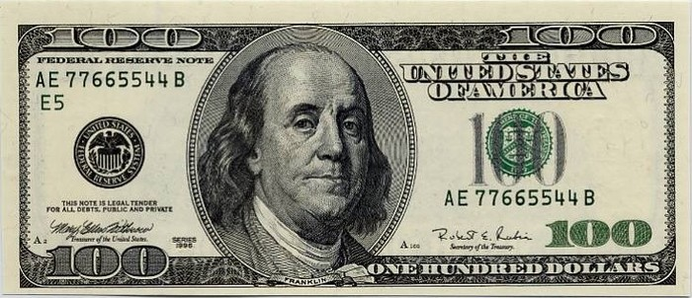

Chabert, you ain’t living like you the OG
Let’s get you threads and your boo back, ASAP
My advice is wise, and it’s to compromise
So let’s give Countess & her monkey a little surprise
Well Countess is living thug, ribbons and curly hair
Holding tight to Grants and Franklins - you better beware!
Looking pretty in pink, with a wink and a smirk
Getting the marriage annulled would drive her beserk

Slide 10
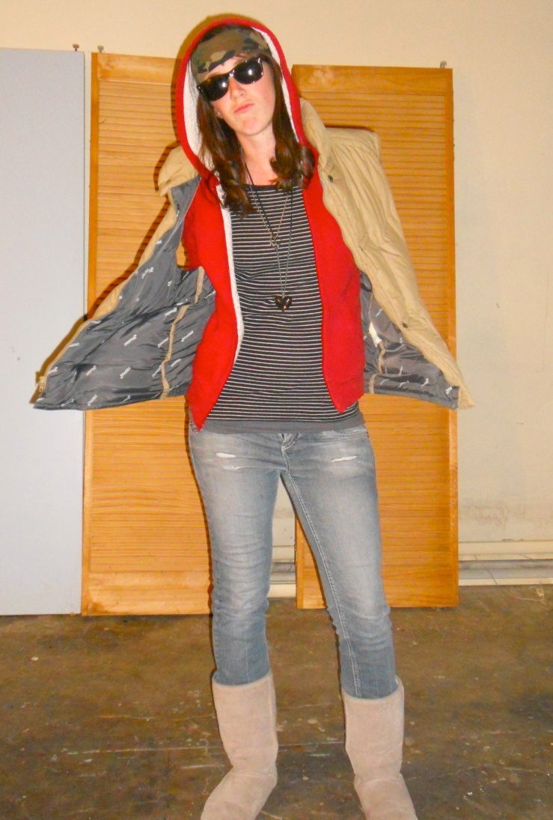
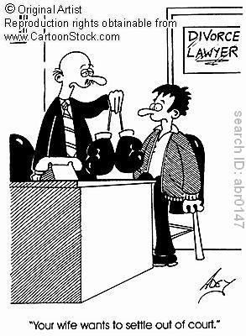
She did get his letter, that beastly Madame Ferraud
Although claims to the public that her husband’s a fraud
She refuses the ol’ ball and chain his rightful support
But that beezy finally agrees to settle out of court!

Slide 11
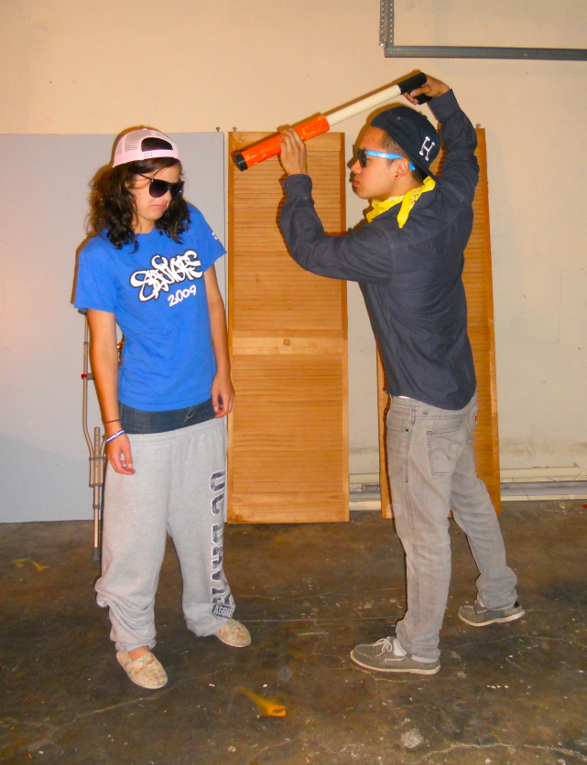

Finally able to dress nice,
He gets backstabbed by his dirty whore wife,
All he wants to do is shoot Madame Ferraud,
But the police would not applaud,

Slide 12
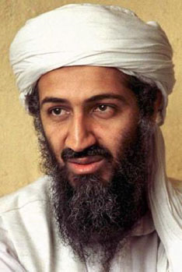
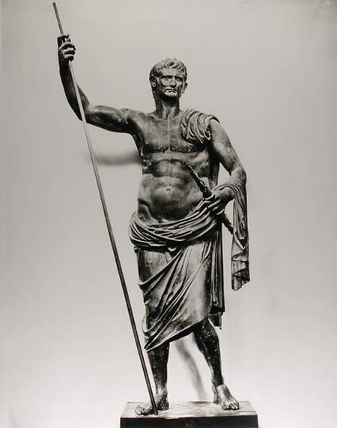
The guy wants to end all the drama,
Kinda like we did Osama,
Never should’ve picked a woman from the street,
A decision he won’t repeat,
Can the war hero get some justice,
It’s not like he’s tryna kill people like Emperor Augustus,

Slide 13


Can the war hero be recognized as alive?
Society is more corruptible than a disk drive,
Nothing is going his way,
Paris is full of foul play

Slide 14
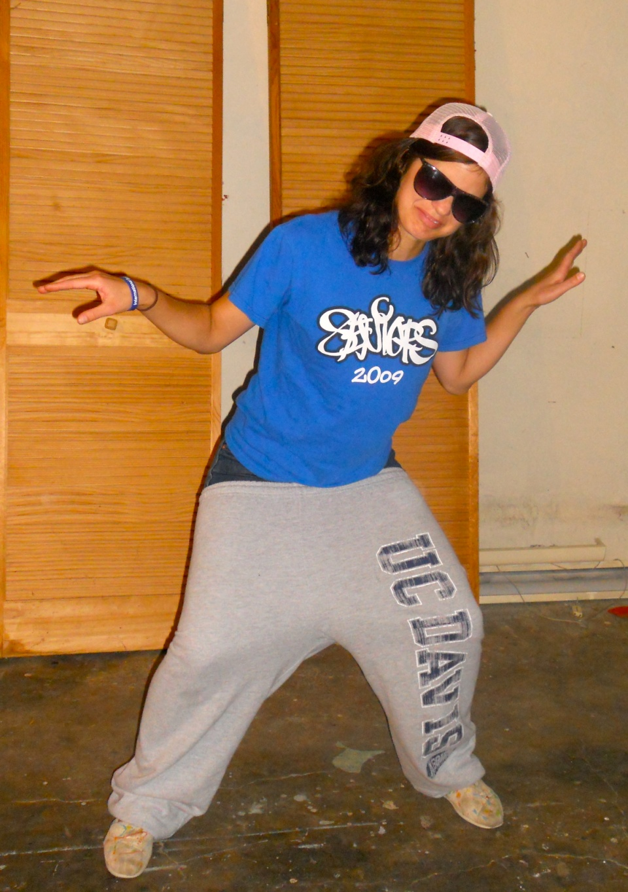
So they’re riding along
She’s singing a song
Of dedication and love
And looking like a dove
Chabert’s taken in
To the reader’s chagrin
She lies to his face for 3 days straight
Got Delbecq in the back, lying in wait
Doing the dove, gangsta style.

Slide 15


The countess is hard
She goes straight for his heart
To surrender his name
And renounce his claims
She’s as slimy as a squid
The way she’s using her kids
But Chabert catches on
He gets wind of her con
Decides the past is foregone
And says he’ll never be her pawn

Slide 16
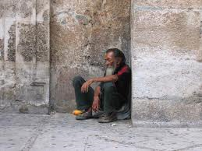
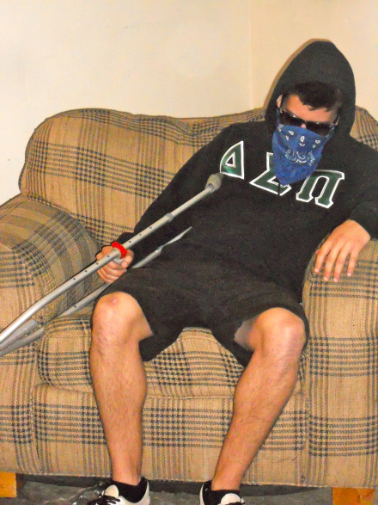
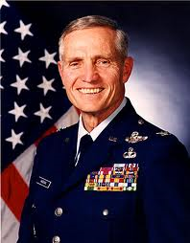
Chabert disappeared into the streets of France
Nothing to his name but some raggity old pants
Once recognized as a war time hero
Now cast aside like a slum dog zero

Slide 17
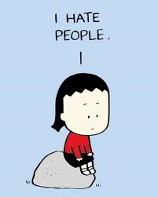
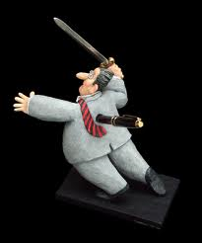
A house for the old is now where he resides
A disgust for humanity built up inside
Always wishin’ he could be a soldier once again
Back when the sword was mightier than the pen

Slide 18
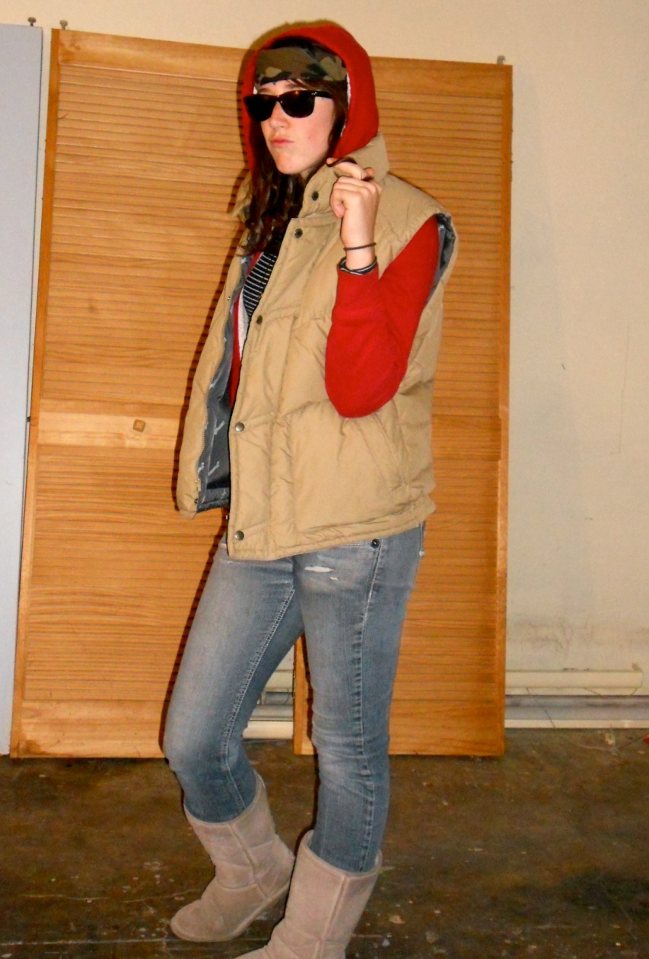

Chabert spends his days drawing lines in the sand
Hatin’ those in robes and cloaks, the law’s right hand
Get ready for some punches, lawyers, doctors and priests
To the General, they’re nothing more than savage beasts

Slide 19

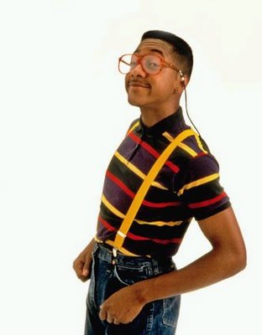
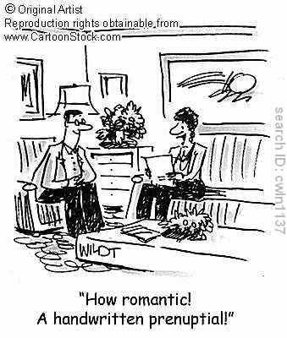
The Countess now claims she’s a woman of the Lord
Lying about her husband? She should get an acting award
Here’s the bottom line: the law will not assist
So sign a prenup and marry well - or you’ll be pissed
The Colonel’s thoughts are on point, so fresh and swagged out
Word on the street is it’s change
he’ll bring about
Crawled out of the dead, it’s
freakin’ Colonel Chabert
Former General and outspoken regarding laissez faire

Slide 20
