Slide 1
Bob Dylan
Group 27
Joshua Mendelson
Edward Quilligan
Rebecca Thomas
Austin Llach

Slide 2
Brief Background
Bob Dylan is the American singer, songwriter, poet, and painter.
Most of his celebrated works date from the 1960’s where he was a reluctant icon during a period of social unrest
Early lyrics incorporate a variety of political, social, and philosophical, as well as literary influences
A number of his songs such as Blowing in the Wind and The Times They are a-Changin became anthems for the U.S. Civil Rights and anti-war movements

Slide 3
Mr. Tambourine Man
Released in 1965 in the album Bringing It All Back Home
Possesses an almost dreamy like, childish tone throughout the song
Reminiscent of Blake’s Songs of Innocence
A song with a bright expansive melody and has become famous in particular for its surrealistic imagery.
Has been covered by many artists, including The Birds in which the track reached #1 on Billboards Top 100.

Slide 4
1960’S
A time of political and social revolution
1963 Assassination of President John F. Kennedy
Lyndon Baines Johnson succeeded President Kennedy
1964 LBJ convinced congress to pass the Civil Rights Act of 1964
1965 LBJ achieved the passage of the Voting Rights Act
1965 LBJ signs the Immigration Act of 1965

Slide 5

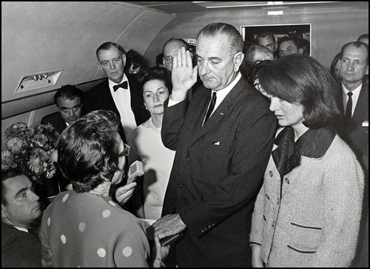

Slide 6
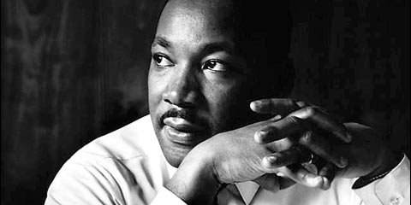

Slide 7
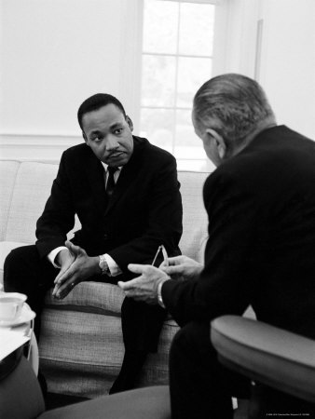

Slide 8
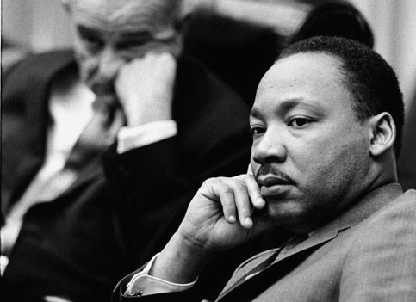

Slide 9
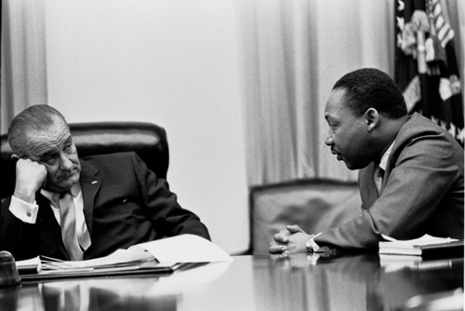

Slide 10
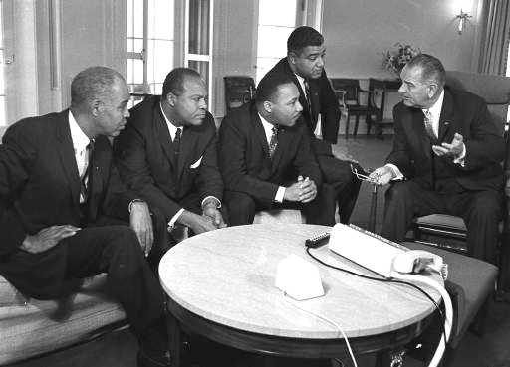

Slide 11
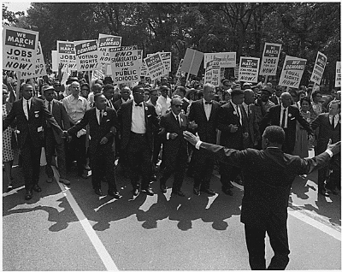

Slide 12
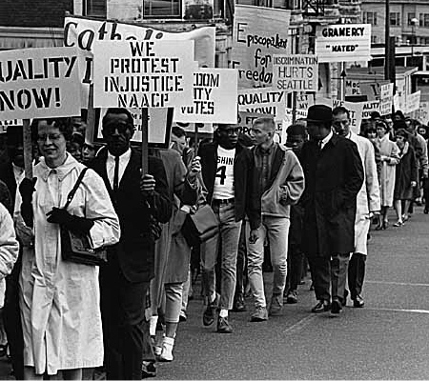

Slide 13
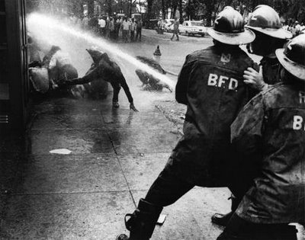

Slide 14
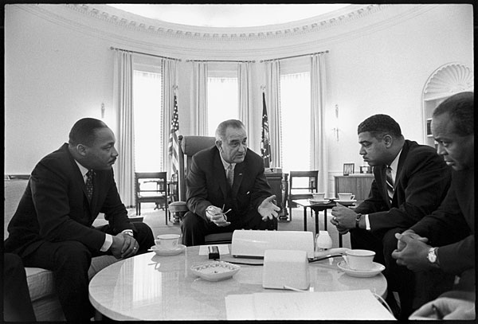

Slide 15
Like A Rolling Stone
In 1965 Bob Dylan had just finished a tour in England and he was upset how the public thought of him
Playboy interview – He expressed how he was going to quit singing, and that this song was the reason he did not

Slide 16
Like A Rolling Stone
Originally made with a piano then switched to rock music style
Columbia Records was reluctant to release the song because it was over 6 minutes and they didn’t like the heavy electric sound
The song was leaked and djs played the songs at clubs
Released as a single in 1965
Made it to number 2 on US charts and became a worldwide hit

Slide 17
Like a Rolling Stone
Supposedly written about Edie Sedgwick
Edie was an American Actress best known as being one of Andy Warhol's superstars
The song is about a girl who has forsaken integrity, honesty, and family for a life of fun and glamour

Slide 18
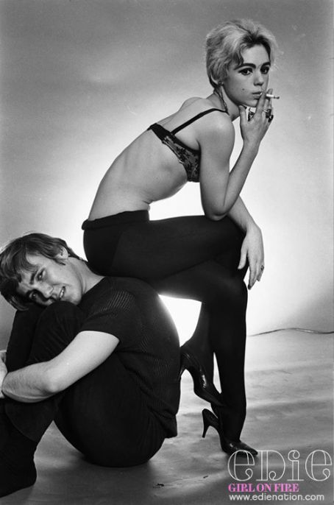

Slide 19
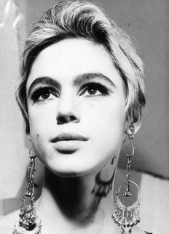

Slide 20
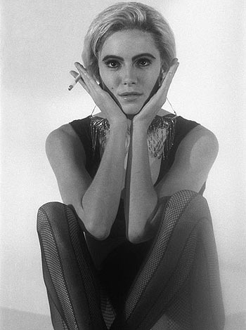

Slide 21
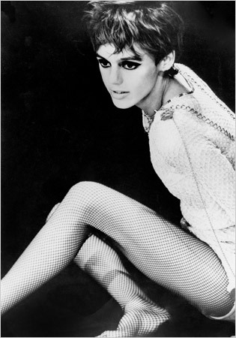

Slide 22
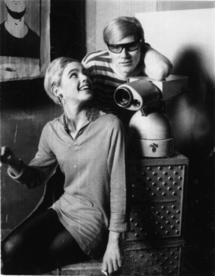

Slide 23
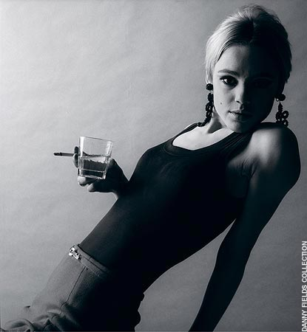

Slide 24
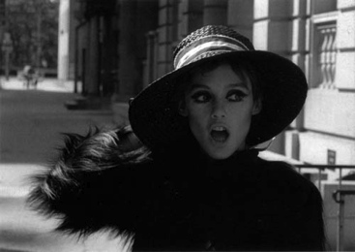

Slide 25
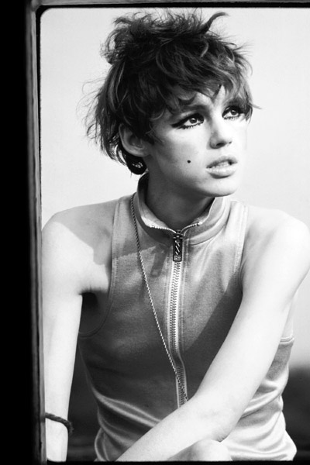

Slide 26
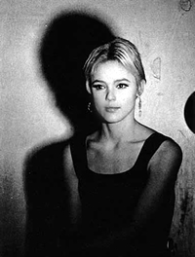

Slide 27
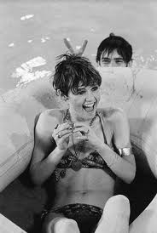

Slide 28
